Slide 1
From the Idea to the Business Case – How Switzerland's Legal Regime Supports Crypto Projects
Dr. André Terlinden, LL.M
Attorney-at-law
Swiss Russian Chamber of Commerce
Webinar
21 September 2021

Slide 2
Agenda
Switzerland's Approach to Cryptocurrencies
Legal Background
Financial Licences in Switzerland
Business Cases
How to set up a Swiss structure

Slide 3
1. Switzerland's Approach to Cryptocurrencies
Swiss government and regulator (FINMA) have a very positive attitude towards cryptocurrencies. Early adaptors.
Crypto Valley in Zug.
Legal framework for blockchain is being drafted. Active regulator (wordwide first ICO guidance). DLT-Act effective in 2021.
Current legal framework provides for adequate regulations, in particular the banking act, anti-money laundering regulations and the act for financial services.
Case-by-case assessment by FINMA: no-action letter

Slide 4
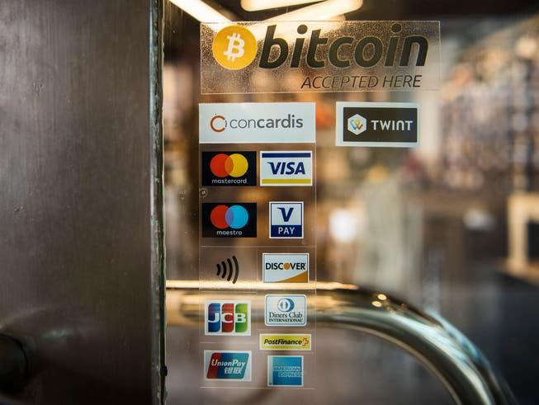
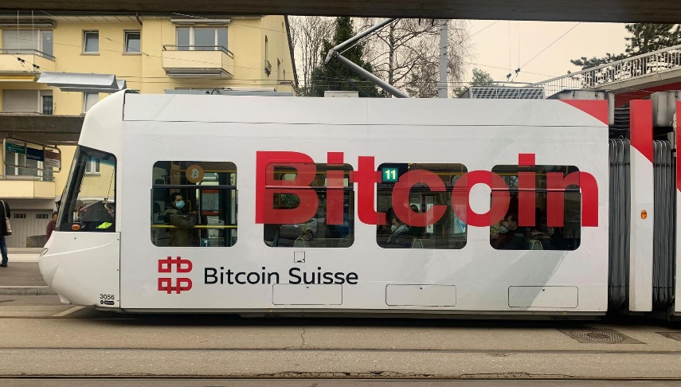
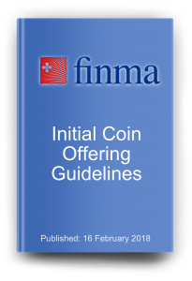
nzz.ch
https://www.20min.ch/story/bitcoin-suisse-gesuch-bankenlizenz-894010373221
finma.ch
https://blockchain.rlp.li/ico-tge-uto-in-liechtenstein/

Slide 5
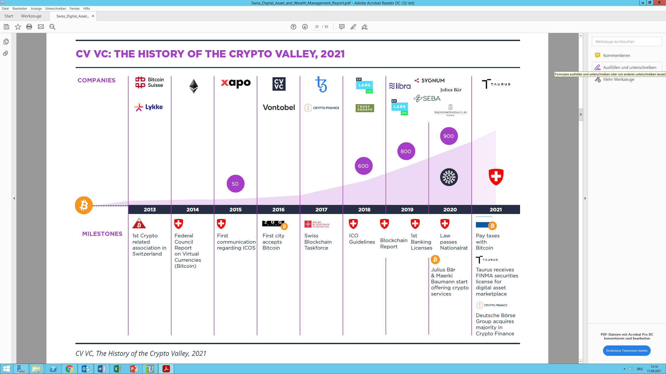

Slide 6
2. Legal Background
No specific rules for ICO. FINMA ICO Guidelines:
Payment tokens (pure cryptocurrencies) are tokens used as means of payment for acquiring goods or services or money transfer (Bitcoin, Ethereum).
Utility tokens: provide access digitally to services
Asset tokens: represent assets such as a debt or equity claim against the issuer: share in future company earnings or physical assets to be traded on a blockchain infrastructure. Economic function is similar to equities, bonds or derivatives.
Non-Fungible Tokens (NFT)?

Slide 7
2. Legal Background
Non Fungible Tokens (NFT)
It depends…
on the economic reality of the transaction and the manner in which the digital asset is offered and sold.
No securities, since not exchangeable (not fungible) because the work or product already exists (e.g. piece of art).
However, financial derivatives (securities) may be created (i.e. value depends on an exchangeable underlying asset).
Profit participations rights are linked to the NFT that might be traded on a secondary market = securities

Slide 8
3. Financial Licences
Traditional Financial Licences
Banking Licence: deposits from the public, lending, interest
Securities Dealer Licence: creating and trading with securities tokens
Trading Platform Licence (organized trading facilities): platform for multilateral trading in financial instruments (not Bitcoin)
Portfolio Manager: management of third party assets based on power of attorney

Slide 9
3. Financial Licences
Innovative Financial Licences
Financial intermediary non-banking sector: application with a self-regulatory organisation (SRO) to ensure compliance with AML
Enables OTC trading by means of settlement accounts
Fintech Licence: deposits from the public (CHF 100m max.), but no interest/no lending
Sandbox: no more than CHF 1m deposits from the public

Slide 10
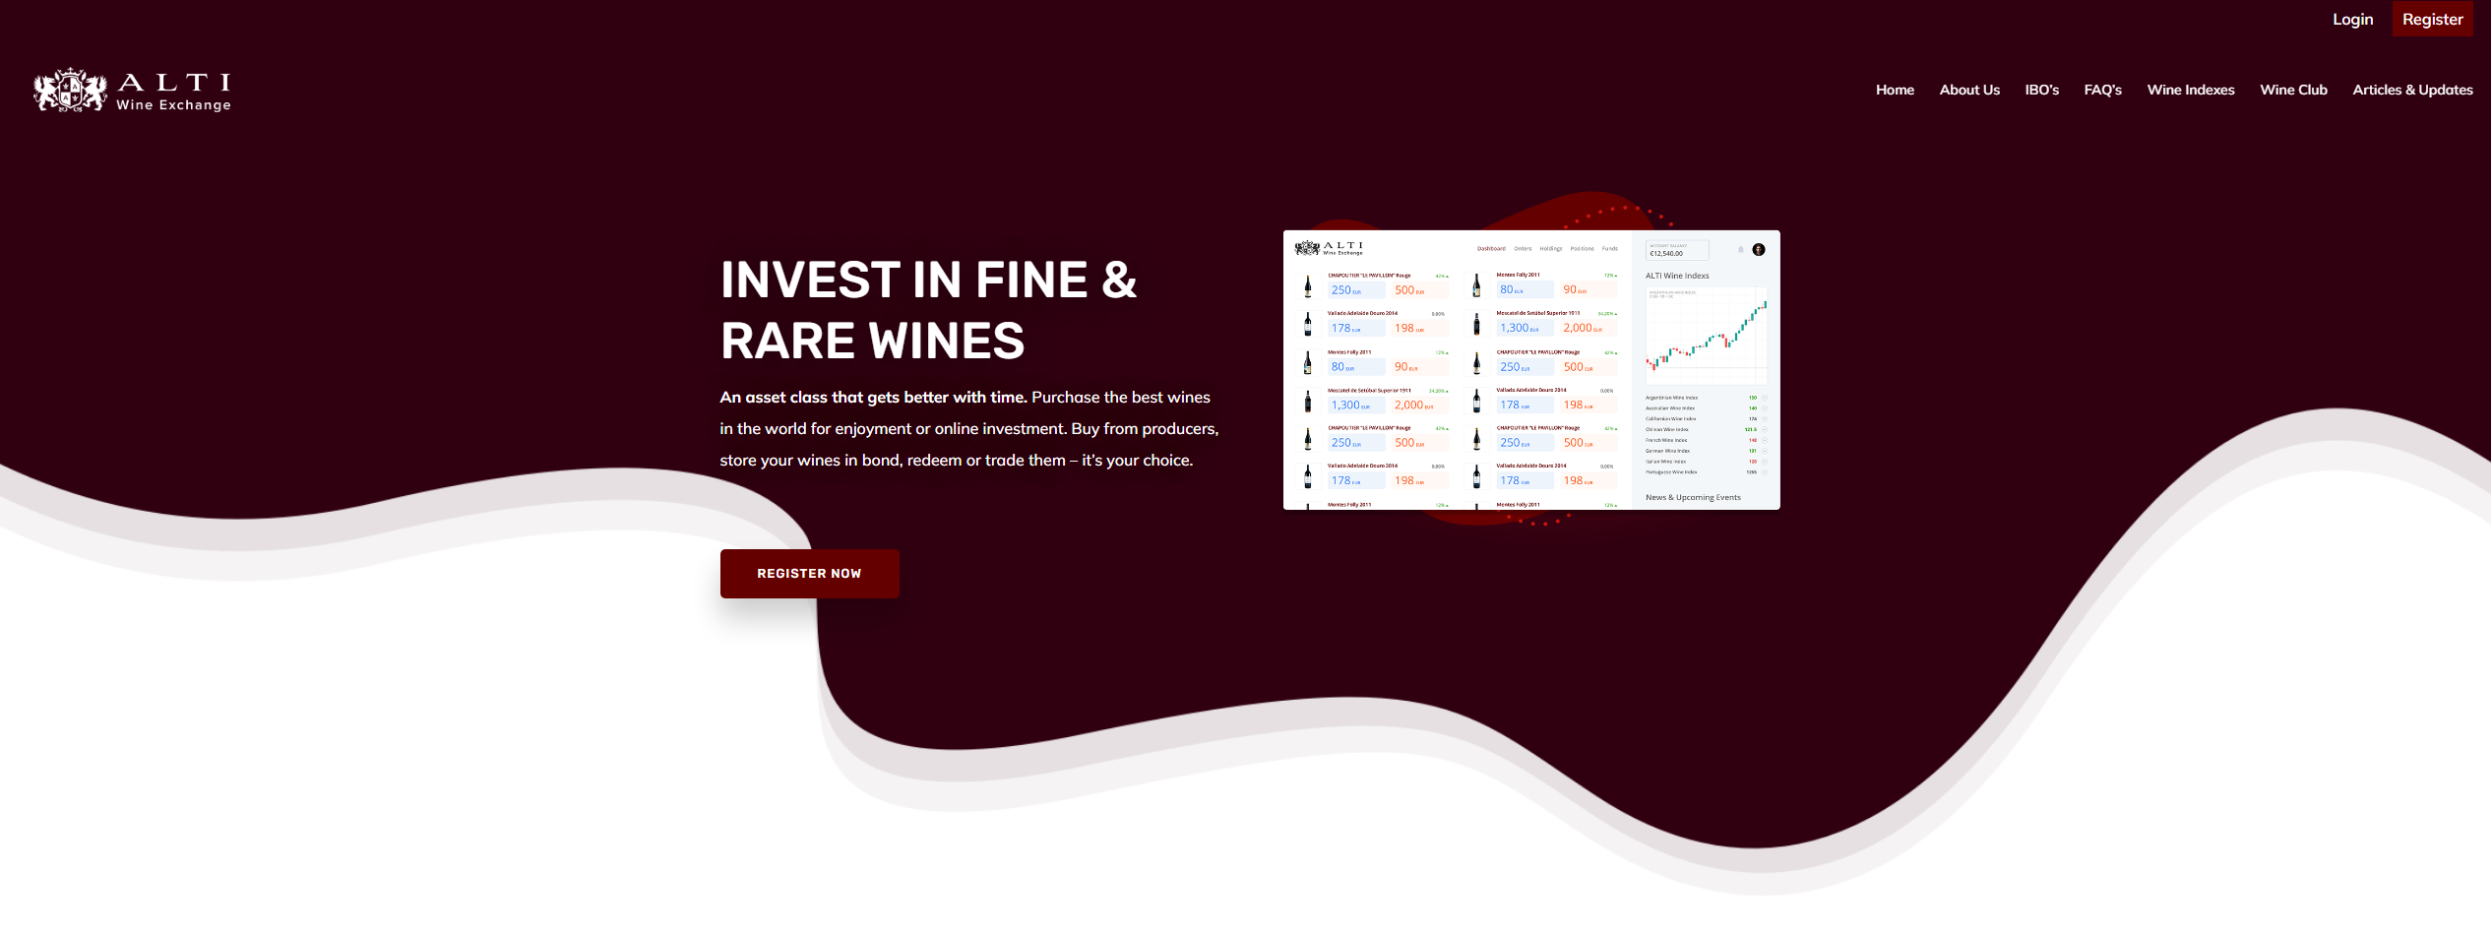
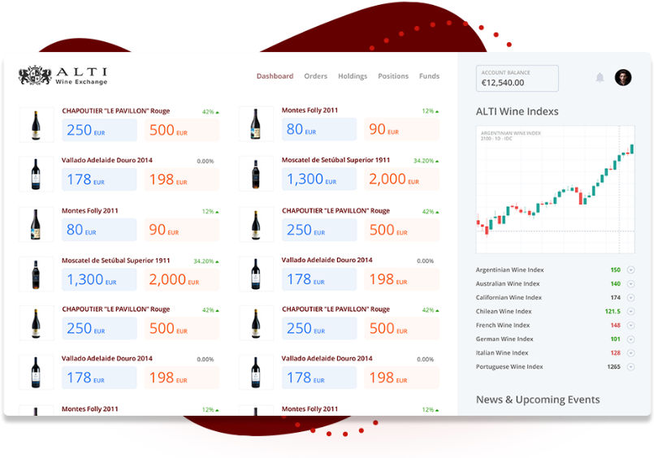
4. Business Cases
www.altiwineexchange.com

Slide 11
4. Business Cases
Tokenization of Rare Wine for Investment Purposes
Alti Wine Exchange buys for example 50 bottles of Champagne Boerl & Kroff from the French wine producer
The wine is stored in a bonded warehouse (no VAT or custom duties) in the name of Alti Wine Exchange.
Alti Wine Exchange issues NFT: each represent one specific, individualized bottle of wine. Investors purchase the NFT (IBO)
Investors hold the NFT an a wallet and can either sell it or have it "burnt" i.e. return in exchange for delivery of wine.
Alti Wine Exchange Licences?
Issuance of NFT need no financial licence
OTC between investors is money transmitting (AML-duties)

Slide 12
4. Business Cases
OTC Trading
Swiss company enabling peer to peer crypto trading
BTC/ETH
Matching? AML-duties (SRO membership)
Wallets for clients? Bank licence
Asset Tokens = Securities
Matching only? AML-duties (SRO membership)
Accounts for clients? Securities dealer licence
NFT
Matching only? AML-duties (SRO membership)
wallets for clients? AML-duties (SRO membership)

Slide 13
5. How to set up a Swiss structure
Setup of a Swiss stock corporation (Aktiengesellschaft)
Preferred option for Russian investors to do business in Switzerland
Swiss stock corporation is a company divided by shares.
Paid-in capital of minimum CHF 100'000.-. The capital is not blocked and can be used for business purposes.
(Sole) Russian shareholder possible as well as Russian board members. 1 Swiss resident director is needed.
Board members are disclosed in commercial register, but no information on shareholders is publicly available.

Slide 14
Contact
Dr. André Terlinden, LL.M, attorney-at-law
Neupert Vuille Partners
Dufourstrasse 58
CH-8702 Zollikon, Switzerland
terlinden@nplaw.ch
+41 44 396 80 80
www.nplaw.ch

